Slide 1
إدارة المشروعات الهندسية
Engineering Project Management
الفصل الخامس: هات 213
Lecture5: GANTT CHARTS
Reference:
Industrial Project Management, Concepts, Tools and Techniques (2007)

Slide 2
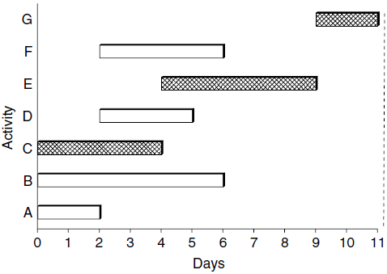
GANTT CHARTS
The Gantt chart is one of the most widely used tools for presenting project schedules.
A Gantt chart can show planned and actual progress of activities.
Gantt chart for our example, using the earliest starting (ES) times is illustrated as follows (A):
The starting time of activity F can be delayed from day two until day 7 (i.e., TS = 5) without delaying the overall project.
(A)

Slide 3
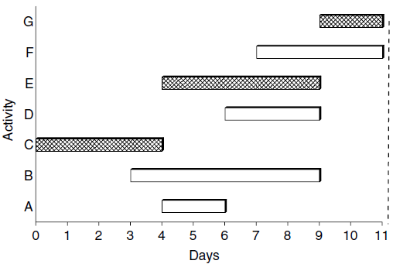
Gantt Chart
Gantt chart for our example based on the latest starting time is illustrated in the figure bellow (B), This represents an extreme case in which activity slack times are fully used.
No activity in this schedule can be delayed without delaying the project.
(B)
(A)

Slide 4
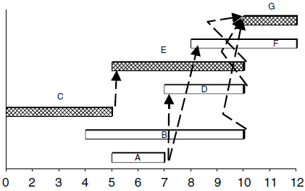
Gantt Chart
The basic Gantt chart does not show the precedence relationships among activities; but the chart can be modified to show these relationships by linking appropriate bars, as in the figure.

Slide 5
Project Crash
Crashing is the expediting or compression of activity duration. Crashing is done as a trade-off between a shorter task duration and higher cost.
If the cost savings on the delay penalty is higher than the incremental cost of reducing the project duration, then crashing is justified.
Normal task duration refers to the time required to perform a task under Normal circumstances.
Crash task duration refers to the reduced time required to perform a task when additional resources are allocated to it.

Slide 6
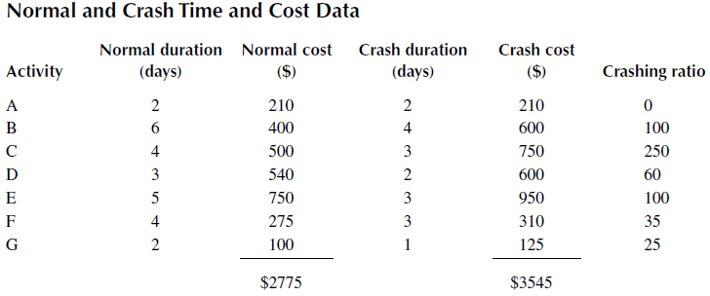
Project Crash
For our example, the normal duration of the project is 11 days, as seen earlier, and the normal cost is $2775.
If all the activities are reduced to their respective crash durations (as in the table), the total crash cost of the project will be $3545.
The crash time is found by CPM analysis to be 7 days

Slide 7

Project Crash
In practice, one would not crash all activities in a network. Rather, some selection rule would be used to determine which activity should be crashed and by how much.
One approach is to crash only the critical activities or those activities with the best ratios of incremental cost versus time reduction. The last column in Table above presents the respective ratios for the activities in our example. The crashing ratios are computed as:
Activity G offers the lowest cost per unit time reduction of $25. we may decide to crash activity G first and evaluate the increase in project cost versus the reduction in project duration, and so on.

Slide 8
CPM of fully crashed Network
Crash C
3545$
All Activities Crash
Crash E
3250$
Minimum Total Crash
3000$
cost
2800$
2775$
Normal operation
Crash G
2 4 6 8 10 11
Time (days)

Slide 9
Project Crash
The process can then be repeated for the next best candidate for crashing, which
is activity F in this case. The project completion time is not reduced any further as
activity F is not a critical activity. After F has been crashed, activity D can then be
crashed.
This approach is repeated iteratively in order of activity preference until no further reduction in project duration can be achieved or until the total project cost exceeds a specified limit.

